Slide 1
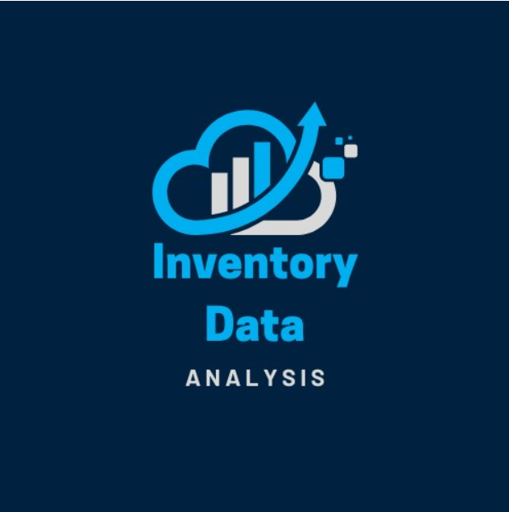
Inventory Data Analysis
Done by :
Ashish Mukati
Grandhi Sri Harini

Slide 2
Introduction
Inventory data analysis is the process of examining and interpreting inventory-related data to optimize stock management and improve operational efficiency. It plays a crucial role in helping businesses maintain the right balance between supply and demand. By analyzing key metrics such as stock levels, inventory turnover, and reorder points, organizations can make data-driven decisions to minimize costs, reduce waste, and enhance customer satisfaction.
This analysis leverages historical and real-time data to identify patterns, forecast future demand,
and pinpoint inefficiencies such as overstocking or stock-outs. Advanced tools like Power BI
enable businesses to visualize inventory trends and track key performance indicators (KPIs)
through interactive dashboards, ensuring timely and informed decision-making.

Slide 3
Aim:
To optimize inventory management by analyzing data, identifying inefficiencies, and providing actionable insights through interactive dashboards for better decision-making and cost reduction.
Scope :
Interactive Dashboard Creation: Develop user-friendly Power BI dashboards with dynamic filters, slicers, and drill-down features for detailed analysis.
Key Metrics Visualization: Display KPIs such as inventory turnover ratio, total inventory value, and reorder trends for actionable insights.
Demand and Trend Analysis: Identify fast-moving, slow-moving, and seasonal items to optimize stock allocation and procurement strategies.
Stakeholder Decision Support: Provide tailored insights for decision-makers to enhance supply chain efficiency and customer satisfaction.

Slide 4
Objective:
To analyze inventory data and provide actionable insights to optimize inventory management
processes.
To reduce operational inefficiencies such as overstocking and stock-outs, ensuring a balanced
inventory system.
To enable data-driven decision-making by leveraging interactive visualizations and KPIs in Power BI.
To identify trends and patterns in inventory, including stock levels, turnover ratios, and category-wise performance.

Slide 5
Tools Used in Power BI
Power Query:
Extract, clean, and transform data from various sources.
Data Modeling:
Create relationships between tables and optimize the data structure.
DAX (Data Analysis Expressions):
Perform advanced calculations and create KPIs.
Visualization Pane:
Build charts, graphs, and interactive visuals for data representation.
Power BI Service:
Publish, share, and collaborate on dashboards with stakeholders.
Slicers and Filters:
Enable dynamic filtering and drill-through analysis.

Slide 6
Problem Statement
Efficient inventory management is a critical challenge for businesses. Poor visibility into stock levels,
demand patterns, and performance metrics often leads to:
Overstocking, increasing holding costs and wastage.
Stock-outs, resulting in missed sales opportunities and customer dissatisfaction.
Inefficient Restocking, causing delays and operational bottlenecks.
Lack of Real-Time Insights, preventing timely and informed decision-making.
This project aims to address these issues by leveraging Power BI to create an interactive inventory analysis dashboard.

Slide 7
Technology
Power Query:
A powerful ETL (Extract, Transform, Load) tool to connect, clean, and transform data from various sources.
Data Modeling:
Create relationships between tables and optimize data structures for seamless analysis.
DAX (Data Analysis Expressions):
A formula language used to create calculated columns, measures, and advanced analytics.
Visualization Tools:
Build dynamic and interactive charts, graphs, KPIs, and dashboards.
Power BI Service:
Cloud-based platform for publishing, sharing, and collaborating on dashboards and reports.
6.Integration Capabilities:
Connect with multiple data sources such as SQL Server, Excel.

Slide 8
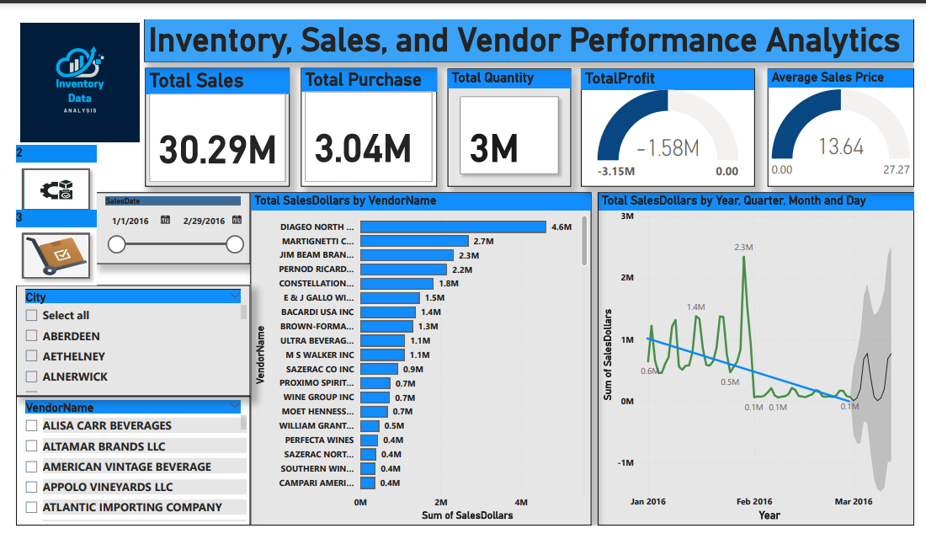
Dashboard

Slide 9
1.Sales Performance:
Total Sales: The total sales recorded are 30.29M, indicating significant revenue generation.
Top Vendors: The vendor with the highest sales is Diageo North with 4.6M sales dollars, followed by Martignetti (2.7M) and Jim Beam Brands (2.3M).
2.Profit Analysis:
The Total Profit is negative (-1.58M), highlighting potential cost inefficiencies or high expenses.
This could suggest the need for a deeper dive into cost structures, pricing strategies, or
operational efficiencies.
3. Average Sales Price:
The Average Sales Price is 13.64, which might require benchmarking against competitors to evaluate competitiveness.

Slide 10
4.Trend Analysis:
The sales trend shows fluctuations over time, with a significant peak reaching 2.3M during February 2016.
There is a declining trend visible in March 2016, warranting further investigation into seasonal factors or market disruptions.
5.Inventory Metrics:
Total Quantity: 3M units are managed in inventory, providing a snapshot of stock levels across all vendors.
6.City and Vendor Filters:
The dashboard provides filtering options by city and vendor, enabling detailed, location-specific, and vendor-specific analysis.

Slide 11
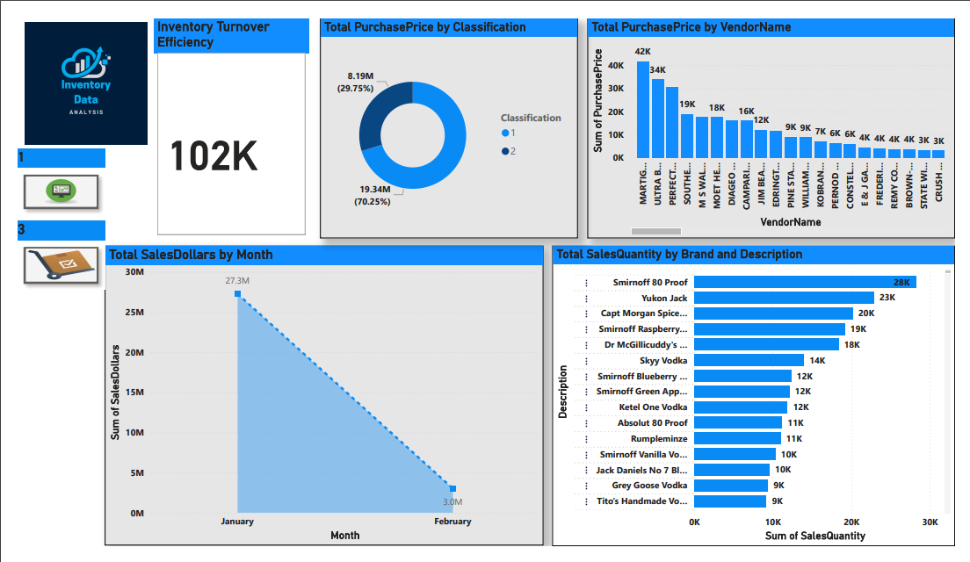

Slide 12
1.Inventory Turnover Efficiency:
The efficiency is reported at 102K, though further context is required to interpret this value fully.
It might represent the number of units sold, revenue, or some other metric tied to turnover.
2.Total Purchase Price by Classification:
Classification 2 accounts for the majority (70.25%) of the total purchase price (19.34M).
Classification 1 contributes a smaller portion, 29.75% (8.19M).
3.Vendor Contribution to Purchase Price:
The top vendors are contributing significantly to purchase price:
with 42K.
PETREMARTIC leads L and other vendors like DIAGEO and M SWAL follow closely in descending order.

Slide 13
4.Total Sales Dollars by Month:
January shows significantly higher sales ($27.3M) compared to February ($3.0M).
This sharp decline could indicate seasonality, operational inefficiencies, or other
external factors.
5.Top Brands by Sales Quantity:
Smirnoff 80 Proof leads in sales with 28K units sold.
Other high-performing brands include Yukon Jack (23K), Captain Morgan Spiced (20K), and Smirnoff Raspberry (19K).
The distribution suggests a heavy reliance on a few top-performing brands.

Slide 14
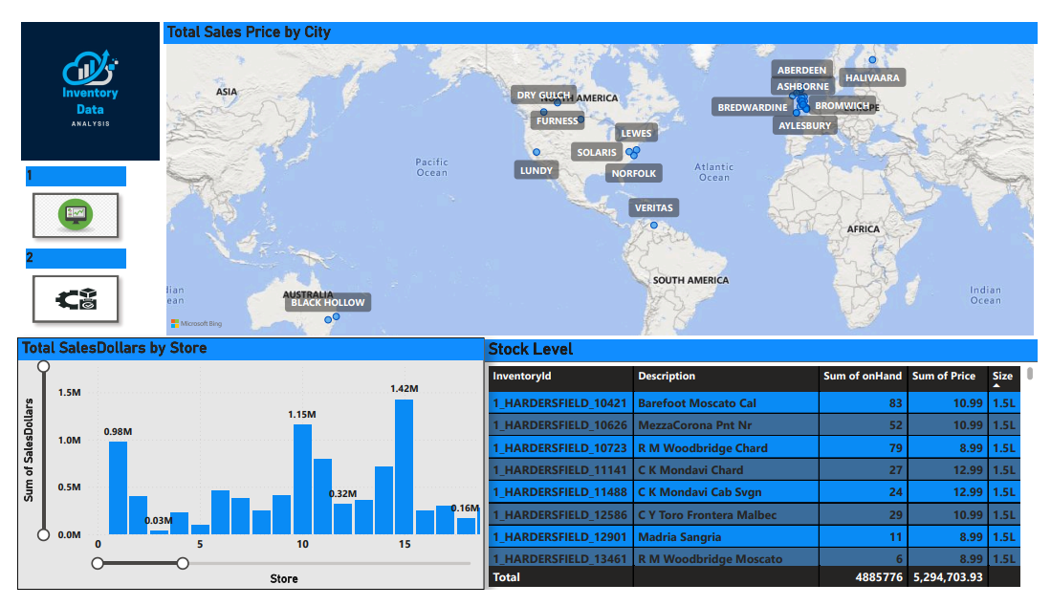

Slide 15
1. Total Sales Price by City:
The map highlights cities across the globe with significant sales contributions. Specific cities such as Black Hollow (Australia), Solaris (North America), Lewes, and others show notable activity.
Regional analysis can help in understanding which locations drive higher revenue and where additional focus may be needed.
2. Total Sales Dollars by Store:
Sales performance varies greatly across stores, with some generating nearly $2M in sales while others are significantly lower.
The variation suggests a high dependence on certain high-performing stores, highlighting potential opportunities to boost underperforming locations

Slide 16
3. Stock Level:
Top Inventory Details:
The stock on hand for different wine brands and sizes is listed, with notable quantities:
Barefoot Moscato Cal (83 units at $10.99) has the highest stock.
Other items like MezzaCorona (52 units) and R M Woodbridge Chard (79 units) are also well-stocked.
Stock Valuation:
The total value of inventory on hand is $5,294,703.93, spread across various stores and products.

Slide 17
Conclusion
The dashboards highlight critical areas for business optimization:
City-Level Insights: Certain cities such as Black Hollow and Solaris are key revenue contributors, suggesting they are high-priority regions for continued investment and strategic promotions.
Store Performance Disparity: The wide range in sales across stores indicates the need to investigate the reasons behind high-performing stores' success and apply those insights to underperforming ones. Tailored marketing and operational strategies can help address this imbalance.
Stock Management: Inventory levels show a mix of overstocking and low stock across various products. Optimizing inventory management can reduce holding costs while ensuring product availability, particularly for popular items.
Revenue Decline: The significant drop in sales from January to February (highlighted in the first dashboard) may indicate seasonal trends or inefficiencies that require further investigation and proactive measures.

Slide 18
Impact
Improved Decision-Making: Real-time insights for data-driven decisions.
Optimized Inventory Management: Reduces overstocking and understocking.
Enhanced Operational Efficiency: Automation of reporting and analytics.
Cost Savings: Reduces holding costs and stockouts.
Better Customer Insights: Personalizes offerings and improves satisfaction.
Accurate Sales Forecasting: Helps predict demand and market trends.
Competitive Advantage: Enables quick adjustments for better performance.

Slide 19


